Slide 1


Using OpenAI-Whisper and NLP to Prevent Toxicity in Online Communication
Apurwa Khanal, Rishabh Bedidha, Brenton Lian, Alex Kim, David Kim
Repository Link

Slide 2


Can AI Neutralize the Threat of Escalating Online Hate?
The Problem: Online voice chat in gaming is largely unmoderated, making it easy for toxic and abusive speech to go unnoticed and unreported. Because voice communication isn’t logged or reviewed, players, especially younger or vulnerable users, have no protection or record when harmful interactions occur.
Impact: Toxic voice communication is more than a brief annoyance, as it can impact mental health while driving people away from online communities. In fact, many studies show that most players have experienced some form of vocal harassment.
Existing solutions fail from:
Failure to monitor voice data, only chat logs
Unreliable manual reporting
Lack of audio evidence

Slide 3
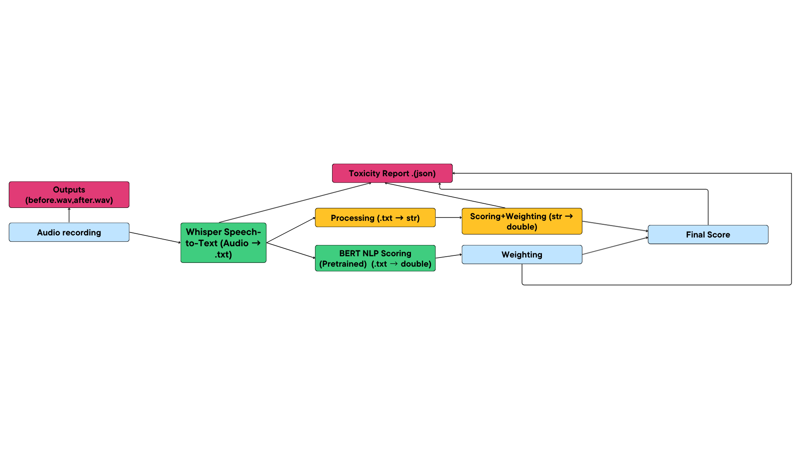

Method and System Overview
Whisper transcribes live audio
No recordings saved, just short text segments
Keyword engine applies multipliers
Direct harassment, slurs, harmful phrases -> boosted severity
Toxic-BERT provides contextual toxicity
Calibration fixes speech-to-text uncertainty + overconfidence
Weighted fusion + thresholding
If final score > 0.65: toxic snippet logged

Slide 4

Conclusion
Results:
Experiment 1 - Keyword Only
Precision: 100%
Recall: 26%
F1: 58.5%
Experiment 2 - Hybrid (Keyword + Toxic-BERT)
Precision: 100%
Recall: 63% (up 142% over baseline)
F1: 87.2%
Key Takeaways:
Transformer context fixes most missed detections
High precision preserved -> minimal false positives
Real-time performance achieved with no audio storage
Future Work:
Multilingual toxicity detection
Domain-specific fine tuning for gaming/voice chat
Conversation-history context (sliding window modeling)

